Slide 1
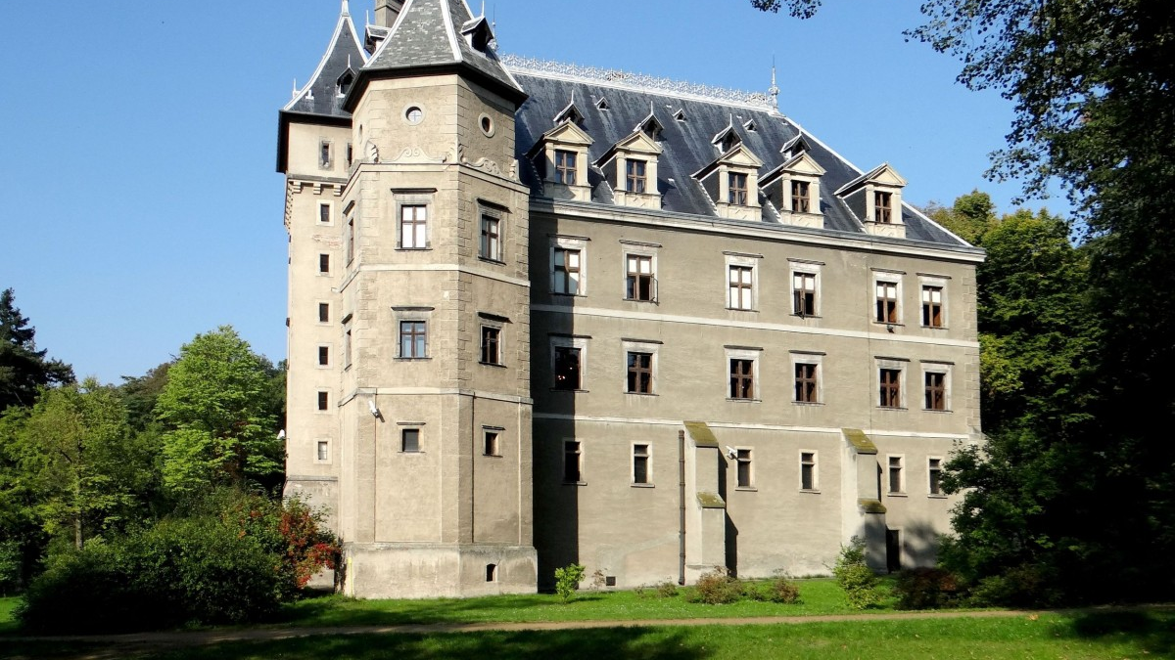
Wielkopolska
Daniel and Sebastian

Slide 2
The Wielkopolska Voivodeship is the third largest voivodeship in Poland.
The Wielkopolska Voivodeship is inhabited by about 3 475 323 people.
About 25% of the area of the Wielkopolska Voivodeship is covered by forests.

Slide 3
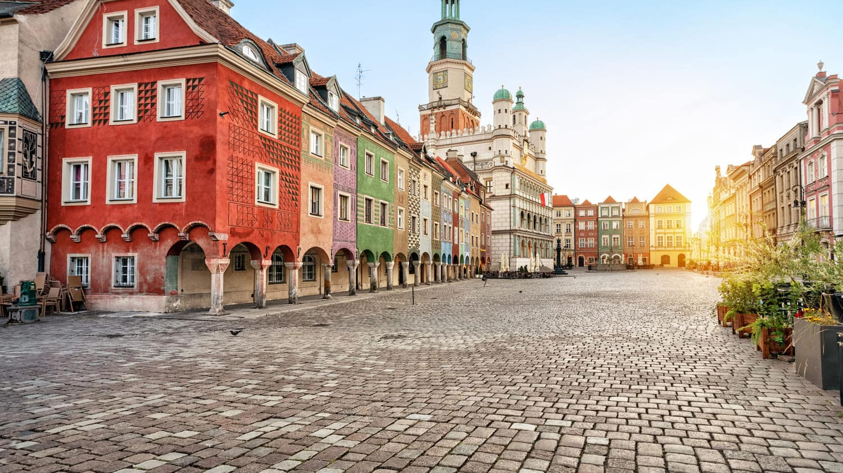
The capital of this voivodeship is Poznań.
Poznań is also the biggest city in Wielkopolska

Slide 4
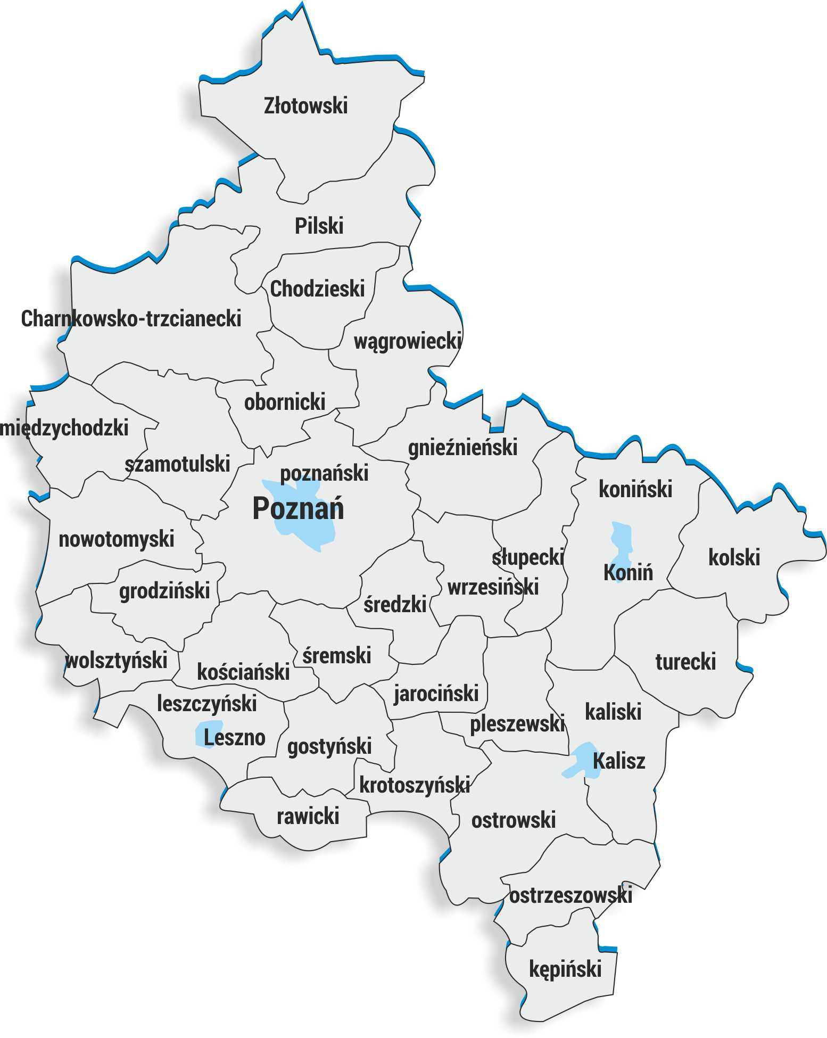
The Wielkopolska Voivodeship has an area of 30 thousand km² (9.5% of the Polish area).
The largest lake is Powidzie (10.36 km²). In the Wielkopolska Voivodeship there is 1 national park (Wielkopolski), and 96 nature reserves and 12 landscape parks.

Slide 5
In this province there is the best football club in Poland, Lech Poznań

Slide 6
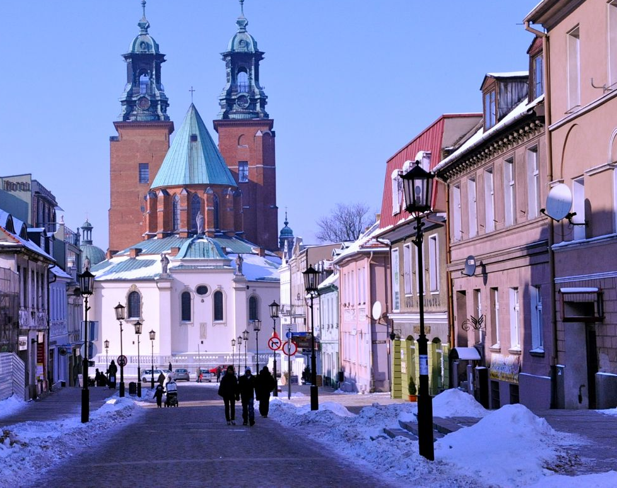
Close to Poznań there is city called Gniezno, the first capital of Poland. According to legend, the city was founded by three brothers named Lech, Czech and Rus. According to her, the white eagle settled on a nearby tree. The brothers decided that it was a sign and built a settlement here, and the eagle is now on our emblem till this day

Slide 7
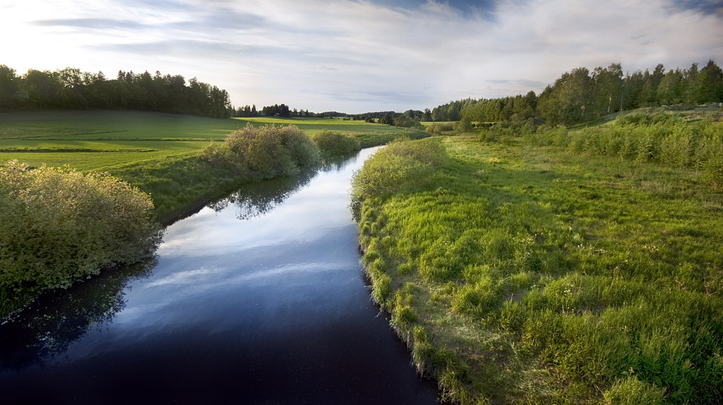
The biggest rivers in Wielkopolska: -Cybina river -Lutynia river -Głoma river -Ner river -Powa river -Gwda river

Slide 8
Thanks for watching

