Slide 1
SMOG LEVEL IN MY REGION/COUNTRY (ROMANIA)

Slide 2
What is smog?
Smog is the result of large amounts of air pollution, especially from the smoke of burning coal, although it is also due to the emission of gases produced by industries or factories and cars.

Slide 3
Types of smog
Ice smog (Alaska) – mixture of gaseous pollutants, dust particles and ice crystals
Photochemical smog (Los Angeles) – is formed during the presence of intense solar radiation, very high temperature values and thermal inversions
Wet smog (London) – the combination of fog and smoke as well as production emissions.

Slide 4
Smog level in ROMANIA
Ensured based on the National System for the Evaluation and Integrated Management of Air Quality (SNEGICA)
SNEGICA implements the ambient air quality law. SNEGICA ensures the organizational, institutional and legal cooperation framework of authorities and public institutions with competences in the field for the purpose of evaluating and managing the quality of the surrounding air, in a unitary manner, throughout the territory of Romania, as well as for informing the population and European and international bodies regarding the quality the surrounding air.

Slide 5
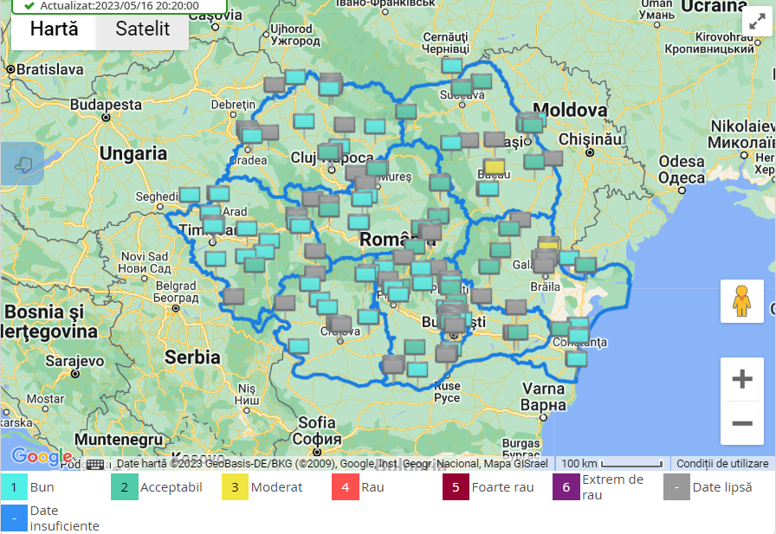
Smog level in ROMANIA
Evaluation of the quality of the surrounding air
Respecting the classification criteria imposed by the European Union, for the purpose of air quality assessment, on the territory of Romania, they were established, according to the provisions of Annex no. 2 of Law no. 104/2011:
13 agglomerations and 41 areas

Slide 6
ENVIRONMENTAL PROTECTION AGENCY (APM)
BISTRIŢA-NĂSĂUD
Established in 2004.
Ensures the population a healthy environment in harmony with economic development.
Leaders in the development project of management plans.
Protected natural areas - a special place from the point of view of the landscape and the presence of rare animals.
Nature reserves and national/natural parks - important at national level.
Natura2000 protected natural areas (Sites) - important at the level of the European Union, can be found throughout Europe.
Endangered or rare plants, fish, animals, birds, insects.
Special landscapes, caves, mountainous areas.
We protect rivers and lakes against pollution.
We protect forests from uncontrolled cutting and fires.
We protect the meadows from fires, intensive agriculture.

Slide 7
Monitoring station
MONITORING | MONITORED POLLUTANTS | SAMPLING POINTS | EXCEEDINGS ACC. TO LAW 104/2011 ON AIR QUALITY 2020
AUTOMATICALLY | SO2 , NOX, CO, O3 C6 H6, PM10 | BN1 STATION | 3 AT PM10 (35 ANNUALLY ALLOWED)
MANUALLY –LAB long-term samples:24h short-term samples: 30 min. | SO2, NO2, NH3 | 4 POINTS IN BISTRITA
 | SEDIMENTABLE DUST | 10 POINTS IN BN COUNTY
 | DUST IN SUSPENSION TSP | 1POINT-HEADQUARTERS APM BN
Situated inside the APM BN headquarters
Representation area of several km/²

Slide 8
Causes of exceedance for the PM10 indicator
Unfavourable meteorological conditions (high humidity)
Increased fuel consumption used for domestic heating due to low temperatures
Use of non-slip material during frost
Car traffic->increased noise

Slide 9
Ecological consequences of smog
Increased air pollution
Health problems (respiratory/heart/skin/swollen eyes etc.)
Damage to crops and wildlife
Reduced visibility

Slide 10
Reflection on our lifestyle to reduce smog
Reduce energy consumption
Choosing alternative energy sources (solar/wind)
Plant more trees
Support green spaces in urban areas by filtering out pollutants from air
Use environmentally-friendly products and means of transport (electrical cars, bikes etc.)

Slide 11
Works cited
http://apmbn.anpm.ro/
http://www.mmediu.ro/
https://www.calitateaer.ro/public/home-page/?__locale=ro

Slide 12
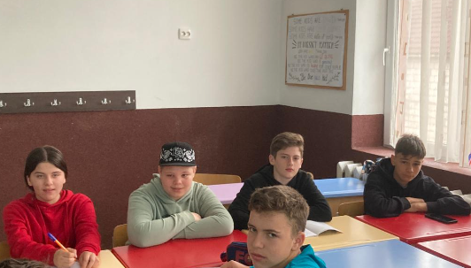
Romanian team
Anamaria Ilieş
Elisabeta Pop
Horaţiu Găurean
Nicu Burduhos
Daniel Leşan
Mario Toader
Marian Ostace

