Slide 1
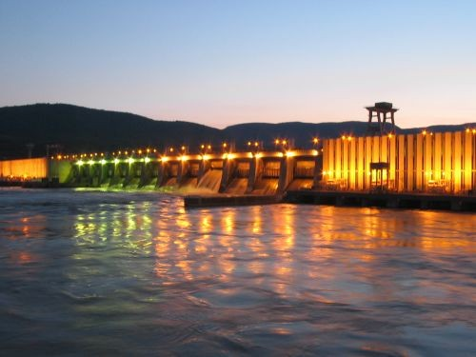
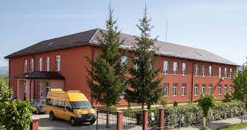
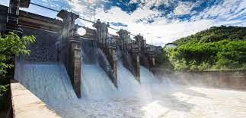
HYDRAULIC ENERGY

Slide 2
What is hydraulic energy?
Hydraulic energy is a type of energy that uses the movement of water. It is sometimes also called water energy and it enables us to obtain electricity by making use of kinetic energy and potential energy from currents and waterfalls.

Slide 3
BENEFITS OF HYDRAULIC ENERGY
It is a renewable energy, therefore it is inexhaustible.
It is a clean energy, it does not pollute, it does not produce gases or toxic emissions.
It is a safe energy, the only fuel used is water.
It is flexible.
It generates jobs.
Reservoirs control the river and this helps reduce risks in case of flooding.

Slide 4
DISADVANTAGES OF HYDRAULIC ENERGY
Hydraulic dams need a site with adequate flow and height conditions.
It alters the life of river fish.
Ample space is needed for the construction of the dams and the hydroelectric plant.
They depend on climate change.
Effects on the environment, causing changes in flora and fauna.
Very expensive investments and constructions.

Slide 5
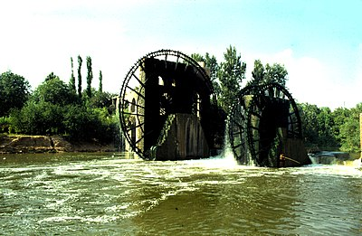
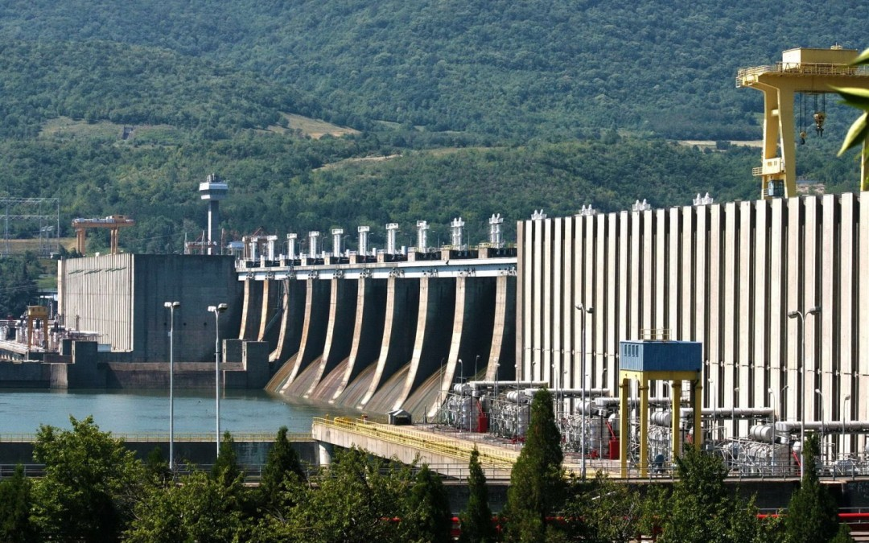
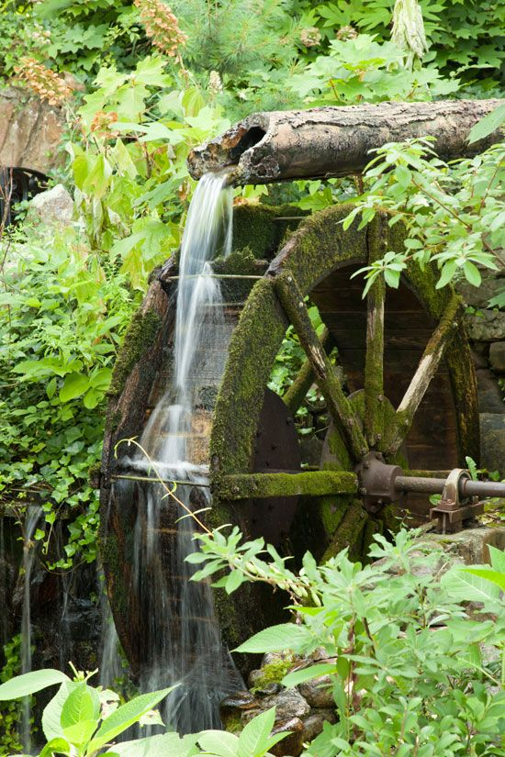
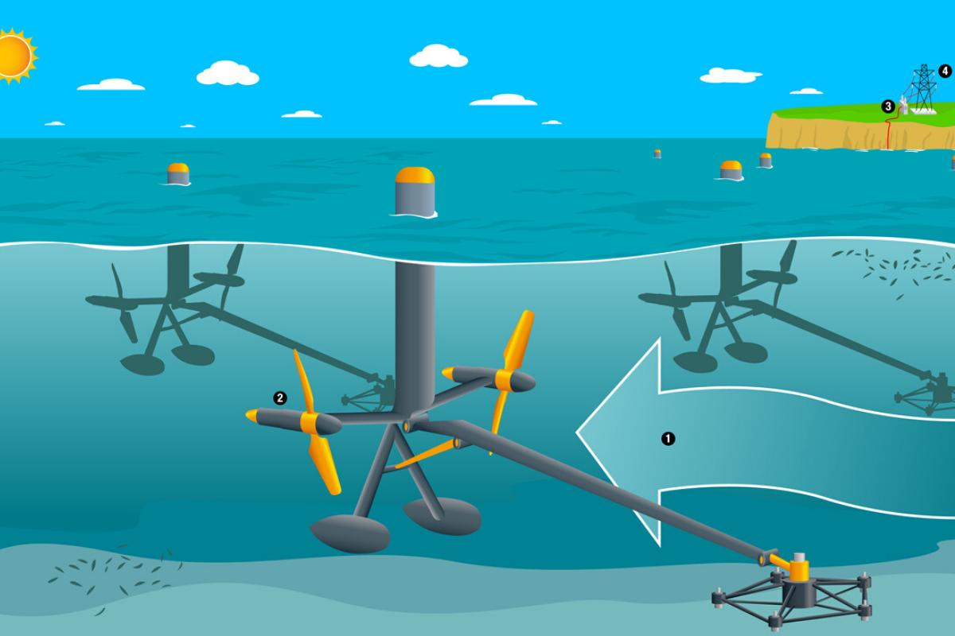
WAYS OF EXPLOITING HYDRAULIC ENERGY
Hydraulic wheels with superior adduction
Hydraulic wheels with inferior adduction
Hydro-power plants
Micro hydro-power plants
Tidal power plants

Slide 6
https://youtu.be/q8HmRLCgDAI

Slide 7
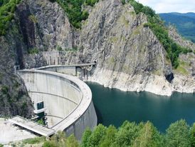
The Vidraru hydroelectric plant
The underground power plant is located more than 100 meters below the level of the Argeș River bed and has impressive dimensions – height 31.70 meters; length 67.80 meters; width 16.70 meters.
The construction of the Vidraru dam and hydropower plant, an objective of strategic importance for the Romanian energy system, began in 1960 and was completed five and a half years later.
The Vidraru hydroelectric plant was put into operation in 1966. At that time, the Vidraru dam was the fifth in Europe and the ninth in the world, among similar constructions.

Slide 8
The Microhydropower plant from Făgăraș

Slide 9
‘Vâltoarea’-the Romanian ecological washing machine
Built of wood, powered by water force
Uses no detergents
=>Impecably-clean clothes/ large textiles (carpets, blankets, traditional wool articles of clothing)
Helped to be built by the entire village
Very rare nowadays, found only in the countryside
Tourist attractions

Slide 10
Vâltoare from Călineşti, Cosăului Valley, Maramureş county, Romania

Slide 11
Romanian team:
Anamaria Ilieş
Elisabeta Pop
Horaţiu Găurean
Nicu Burduhos
Daniel Leşan
Mario Toader
Marian Ostace

