Slide 1
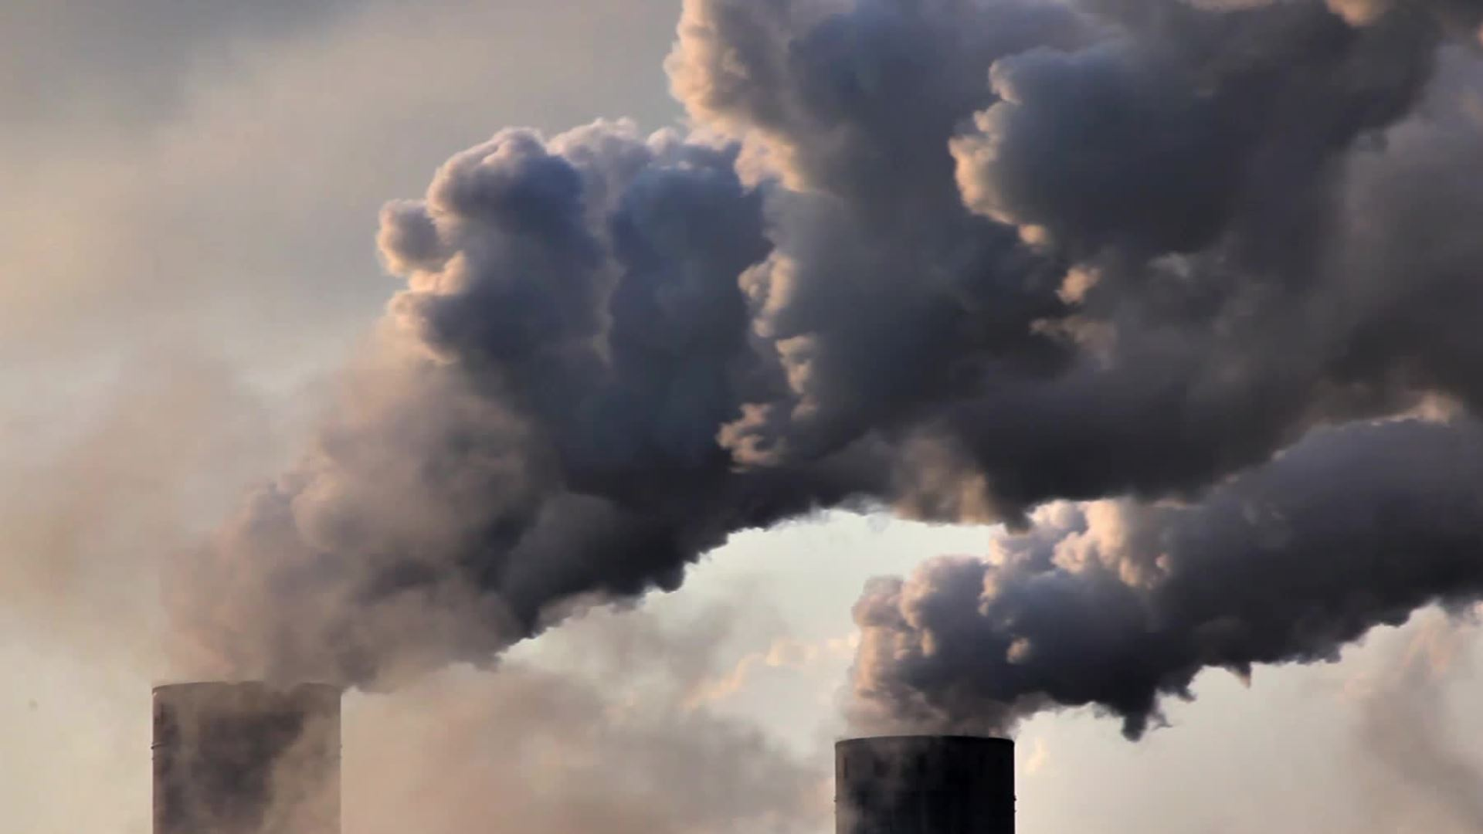
Smog and its consequences
Sebastian and Michał

Slide 2
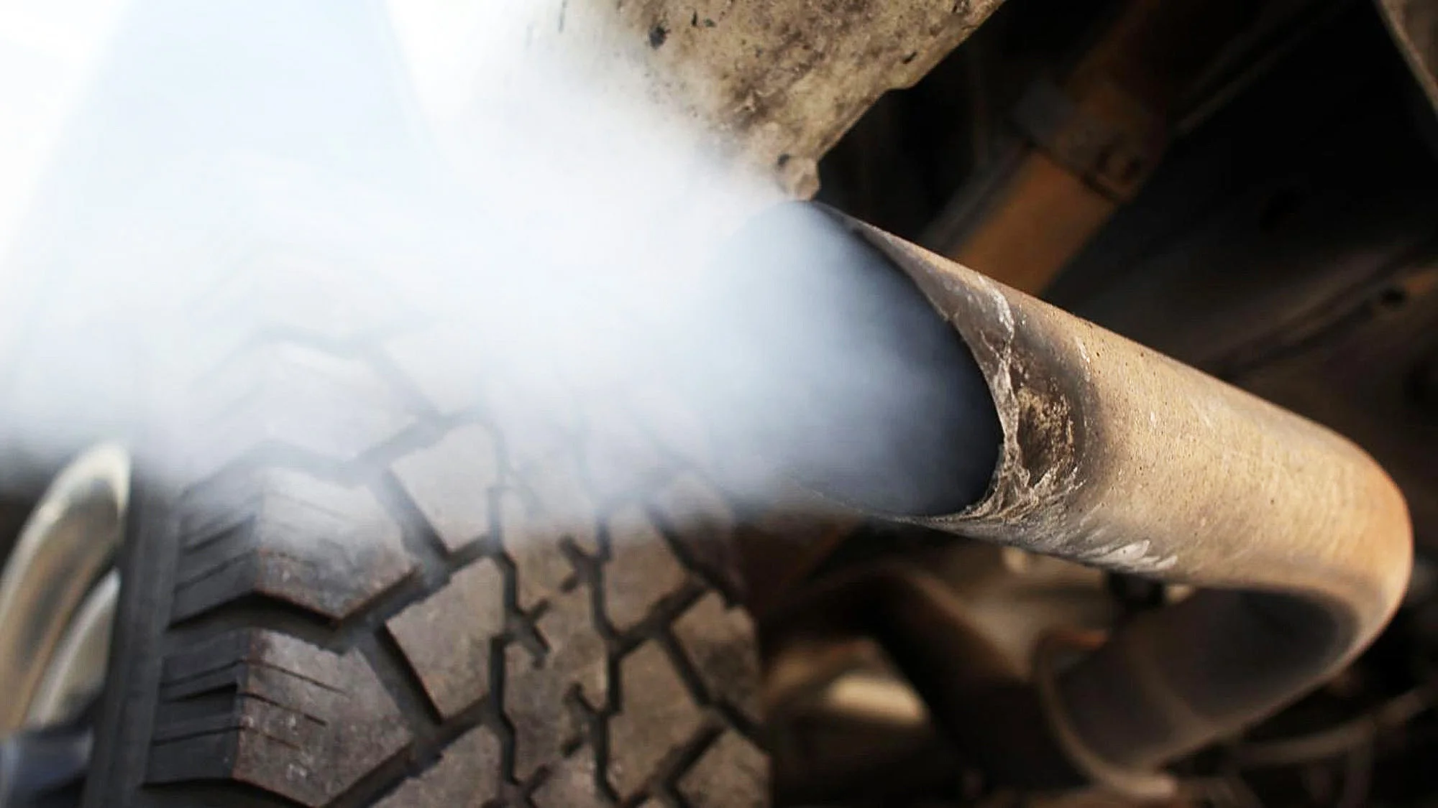
Smog is caused by air pollution by factories, cars and burning in furnaces. It happens that it concerns not only the city, but also the surrounding areas, which it reaches as the so-called incoming smog.

Slide 3
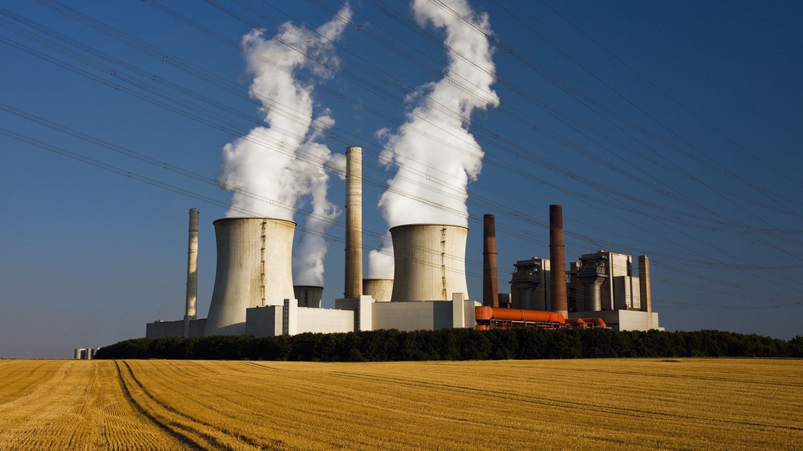
Due to low environmental awareness (and sometimes for economic reasons), also factories and power plants use environmentally harmful heating materials instead of environmentally friendly solutions.

Slide 4
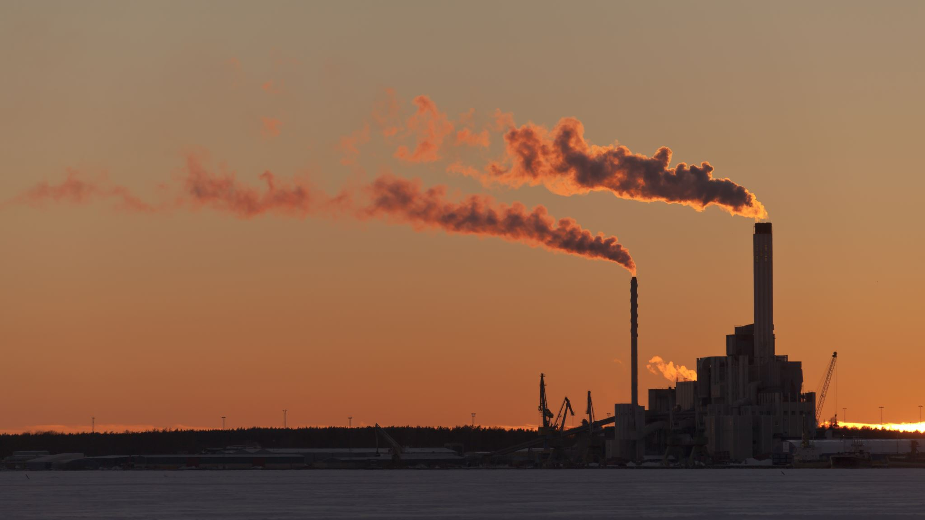
Polish cities have some of the worst air quality in Europe. According to the World Health Organization, 33 of the 50 most polluted cities are in Poland. The industrial south of Poland has been struggling with dangerously high levels of smog for years.

Slide 5
Most of us know that smog has a negative impact on human health, because it can make breathing difficult and cause various types of effects, such as: asthma, circulatory problems, nausea, strokes or even heart attacks. But what are the effects of smog on the environment?

Slide 6
Smog inhibits plant growth by reducing the amount of carbon dioxide absorbed in the process of photosynthesis,
destroys forests and crops,
may lead to the extinction of those animal species that are unable to adapt quickly to new environmental conditions and polluted air.

Slide 7
The most effective method of counteracting smog is to introduce and respect regulations that would prohibit the use of old, substandard furnaces and the burning of poor quality coal products and garbage. People need to understand that by burning waste, they are poisoning themselves, their families and the environment. Other elements that need to be implemented to make smog less harmful are also important. These are, for example, energy from renewable sources and the reduction of car traffic.

Slide 8
Thanks for watching

