Slide 1
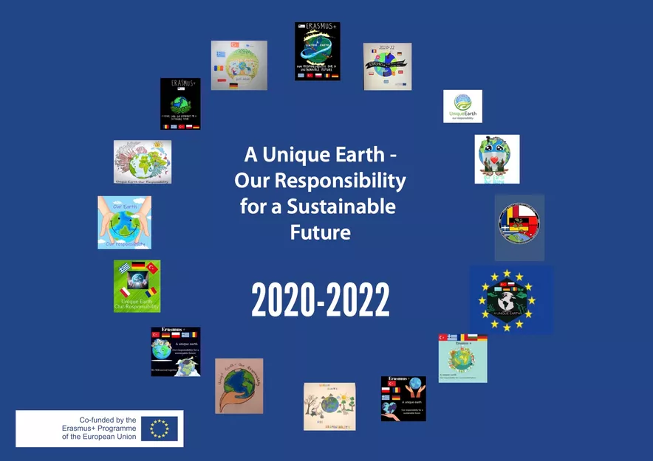
SMOG AND SOLAR POWER IN GREECE
LAKASA Thalia
GALAXIDOU Maria
KARATZIA Nantia
ZAROTIADIS Vasilis
Jaroslav, Poland 2023

Slide 2
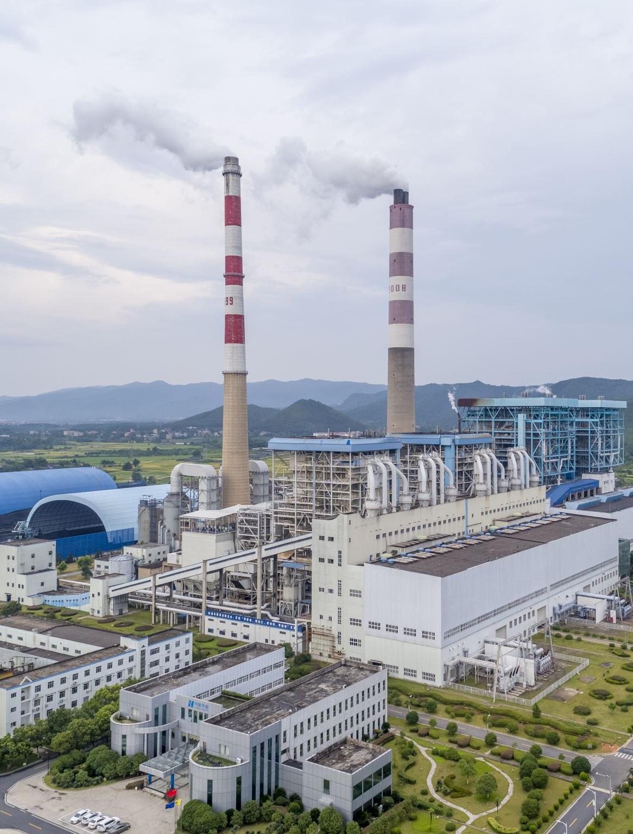
SMOG NORTH GREECE – Region of Central Macedonia
Northern Greece, including cities like Thessaloniki and Katerini, can experience varying levels of smog. The smog levels are influenced by several factors, including industrial emissions, vehicular pollution, weather patterns, and geographical features.
Smog comes in two forms:
A smog is formed when we have a high concentration of pollutants, such as carbon monoxide, sulfur dioxide and suspended particles, in combination with relatively low temperature and high relative humidity.
Photochemical smog occurs when we have high temperatures, great sunshine in intensity and duration, low relative humidity and a high concentration of nitrogen oxides, hydrocarbons, and their secondary products.

Slide 3
Map of the area of Thessaloniki showing its measurement locations air pollution

Slide 4
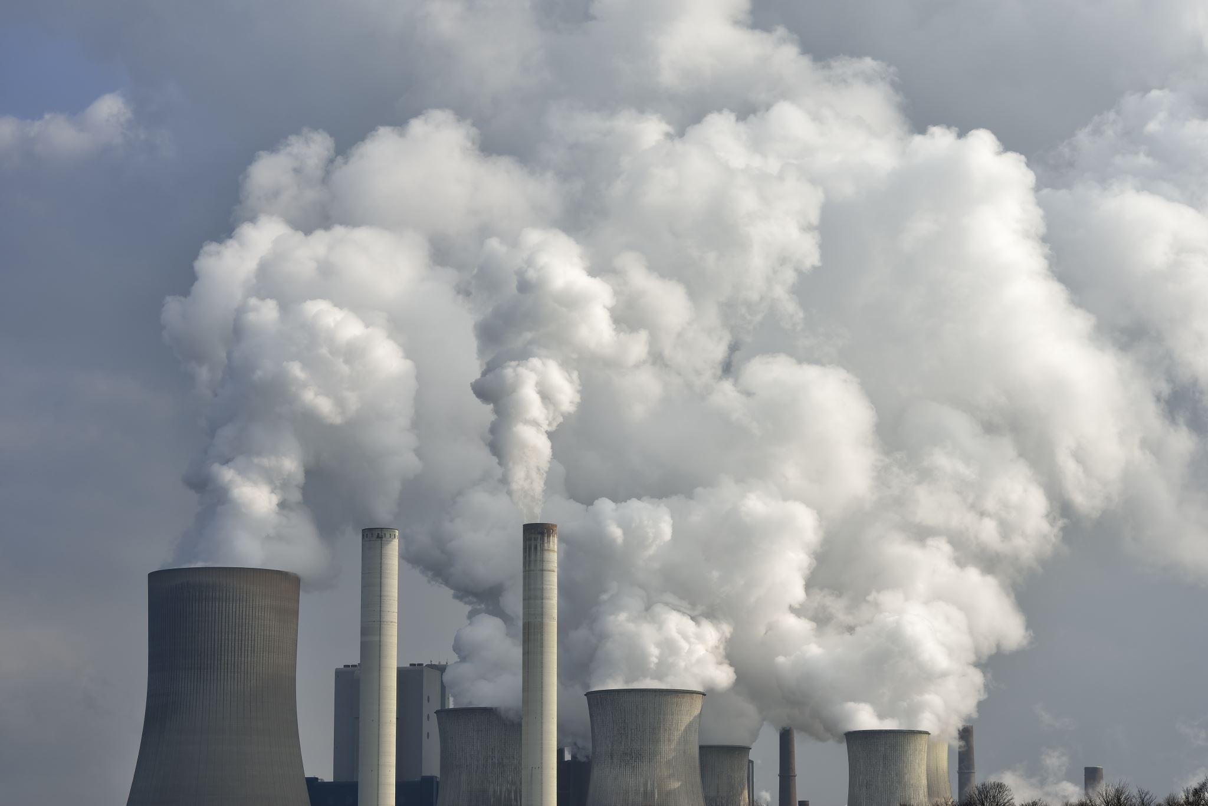
Transport, industrial activities and electricity generation together they are responsible for more than 90% of primary emissions pollutants. The following figure shows the contribution of the various sources to emissions of the main air pollutants in the EU-27: (a) carbon monoxide (CO), (b) nitrogen oxides (NOx), (c) sulfur dioxide (SOx), (d) particulate matter with a diameter of 10 micrometres and below (PM10).
Vehicular pollution, including emissions from cars, trucks, and buses, also plays a significant role in smog formation. High traffic areas and congestion can contribute to increased levels of air pollutants, leading to higher smog concentrations.

Slide 5
Air Quality - Total Road Transport Emissions

Slide 6
The ecological consequences of smog can be severe:
Human Health: Smog can cause respiratory problems, aggravated asthma, lung inflammation, and increased risk of cardiovascular diseases among the population.
Vegetation: High levels of ozone, a component of smog, can damage plant tissues, reduce crop yields, and inhibit photosynthesis.
Ecosystems: Acid rain, which forms when smog pollutants react with moisture in the air, can harm forests, lakes, and aquatic life. Smog also contributes to reduced biodiversity and disrupts ecosystems.

Slide 7
Prevention of Smog
Several measures can be taken to prevent smog formation and reduce its impact:
Industrial Emissions Control: Industries can implement cleaner technologies, such as catalytic converters and scrubbers, to reduce emissions. Strict regulations and monitoring can also be enforced.
Vehicle Emissions Reduction: Encouraging the use of electric vehicles (EVs), promoting public transportation, and implementing stricter vehicle emission standards can help reduce smog.
Renewable Energy Transition: Shifting from fossil fuel-based energy sources to renewable energy sources, such as solar and wind power, can significantly reduce smog-forming emissions.
Energy Efficiency: Promoting energy-efficient practices, such as using energy-saving appliances, proper insulation, and smart energy management, reduces the overall demand for energy and subsequently reduces emissions.
Awareness and Education: Raising awareness about the impacts of smog and educating the public on sustainable practices can encourage behavioral changes and promote a cleaner environment.

Slide 8
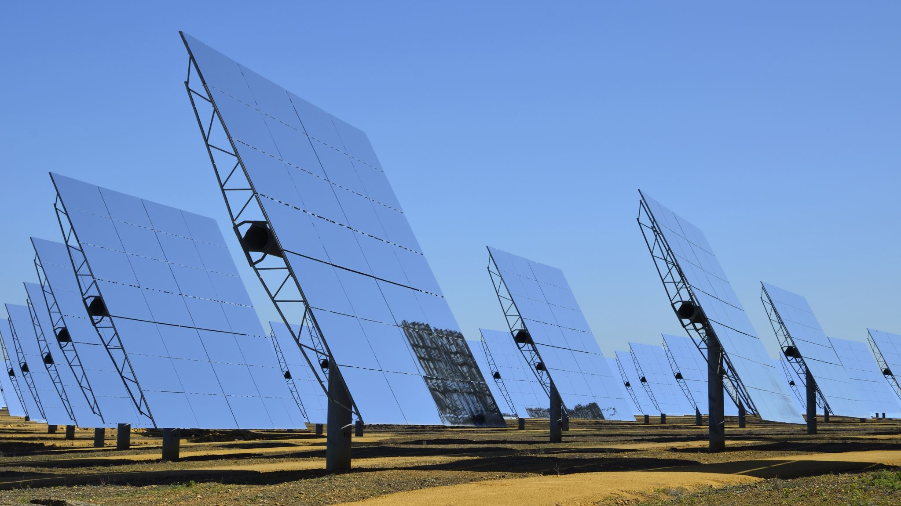
Solar Power
Solar power is a renewable energy source that utilizes the energy from the sun to generate electricity or heat.
Photovoltaic (PV) systems: These systems convert sunlight directly into electricity using semiconducting materials, typically made of silicon, which generate an electric current when exposed to sunlight.
Solar thermal systems: These systems use sunlight to heat a fluid, typically water or oil, which then produces steam to drive turbines and generate electricity or provide heat for various applications.

Slide 9
Solar power offers several advantages:
Renewable: The sun is an abundant and inexhaustible energy source, ensuring a long-term, sustainable energy supply.
Environmentally Friendly: Solar power produces no greenhouse gas emissions or air pollutants during operation, contributing to reduced air pollution and climate change mitigation.
Cost Savings: Over time, solar power installations can lead to significant cost savings on electricity bills.
Versatile: Solar power can be used for various applications, including residential and commercial electricity generation, water heating, and powering remote areas or off-grid systems.

Slide 10
Solar Resources in Greece
Greece enjoys a high solar resource with an average of 2,700 to 3,000 hours of sunshine per year, making it an ideal location for solar power generation.
The country's southern regions, including Crete, Peloponnese, and the Aegean Islands, receive the highest solar irradiance levels, while the northern regions have slightly lower but still favorable solar conditions.

Slide 11
Solar Energy Policies and Targets
Greece has made substantial efforts to promote renewable energy, including solar power, through policy support and incentives.
The country has set renewable energy targets to increase the share of renewables in its energy mix. As of the knowledge cutoff in 2021, the target was to reach 35% of gross final energy consumption from renewable sources by 2030.

Slide 12
Thank you for your attention!

