Slide 1
Smog
Understanding its Impact and Our Role in Combating Pollution

Slide 2
Content
Introduction
Causes of Smog
Smog Levels
Ecological Consequences of Smog
Health Consequences of Smog
Reflection on Our Lifestyles
Solutions to Prevent and Reduce Smog
Individual Actions for Clean Air
Collaborative Efforts
Conclusion
Questions and Answers

Slide 3
Introduction
Particulate matter?
Ground-level ozone?
Notes:
Smog is a type of air pollution characterized by a hazy or foggy appearance in the atmosphere. It is primarily caused by the interaction of sunlight with certain pollutants emitted from various sources, resulting in the formation of a mixture of harmful substances in the air.
Components of Smog:
Particulate Matter: Particulate matter refers to tiny particles suspended in the air, which can be solid or liquid. These particles can vary in size and composition, ranging from dust, soot, and smoke to droplets of liquid. Particulate matter can be directly emitted from sources such as vehicle exhaust, industrial emissions, and burning of fossil fuels. It can also be formed indirectly through chemical reactions in the atmosphere.
Ground-Level Ozone: Ground-level ozone, also known as tropospheric ozone, is a secondary pollutant formed by the reaction of nitrogen oxides (NOx) and volatile organic compounds (VOCs) in the presence of sunlight. It is not emitted directly into the atmosphere but forms as a result of pollutants released by various sources, including vehicles, power plants, and industrial processes. Ground-level ozone is harmful to both human health and the environment.
Both particulate matter and ground-level ozone are major components of smog and contribute to its harmful effects on air quality, human health, and the environment. It is important to address and reduce the emissions of these pollutants to mitigate the impact of smog.

Slide 4
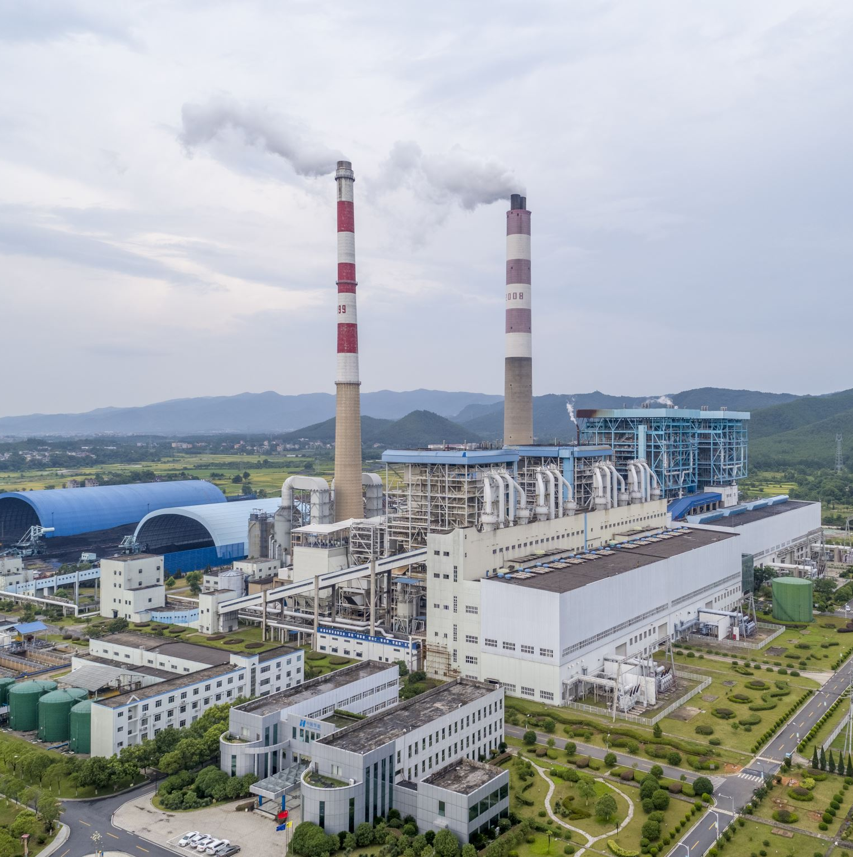
Causes of Smog
Transportation emissions (vehicles, airplanes, ships)
Industrial activities (power plants, factories)
Residential heating and cooking methods
Agricultural practices (burning of crop residues)

Slide 5
Smog Levels
AQI | Air Pollution Level | Health Implications | Cautionary Statement
0 - 50 | Good | Air quality is considered satisfactory, and air pollution poses little or no risk | None
51 -100 | Moderate | Air quality is acceptable; however, for some pollutants there may be a moderate health concern for a very small number of people who are unusually sensitive to air pollution. | Active children and adults, and people with respiratory disease, such as asthma, should limit prolonged outdoor exertion.
101-150 | Unhealthy for Sensitive Groups | Members of sensitive groups may experience health effects. The general public is not likely to be affected. | Active children and adults, and people with respiratory disease, such as asthma, should limit prolonged outdoor exertion.

Slide 6
Smog Levels
AQI | Air Pollution Level | Health Implications | Cautionary Statement
151-200 | Unhealthy | Everyone may begin to experience health effects; members of sensitive groups may experience more serious health effects | Active children and adults, and people with respiratory disease, such as asthma, should avoid prolonged outdoor exertion; everyone else, especially children, should limit prolonged outdoor exertion
201-300 | Very Unhealthy | Health warnings of emergency conditions. The entire population is more likely to be affected. | Active children and adults, and people with respiratory disease, such as asthma, should avoid all outdoor exertion; everyone else, especially children, should limit outdoor exertion.
300+ | Hazardous | Health alert: everyone may experience more serious health effects | Everyone should avoid all outdoor exertion
Notes:
Source Air Quality Index Scale and Color Legend (aqicn.org)

Slide 7
Ecological Consequences of Smog
Damage to vegetation and crops
Harm to wildlife and aquatic life
Acidification of lakes and rivers
Depletion of ozone layer leading to climate change

Slide 8
Health Consequences of Smog
Respiratory problems (asthma, bronchitis, lung cancer)
Cardiovascular issues (heart attacks, strokes)
Allergies and skin irritations

Slide 9
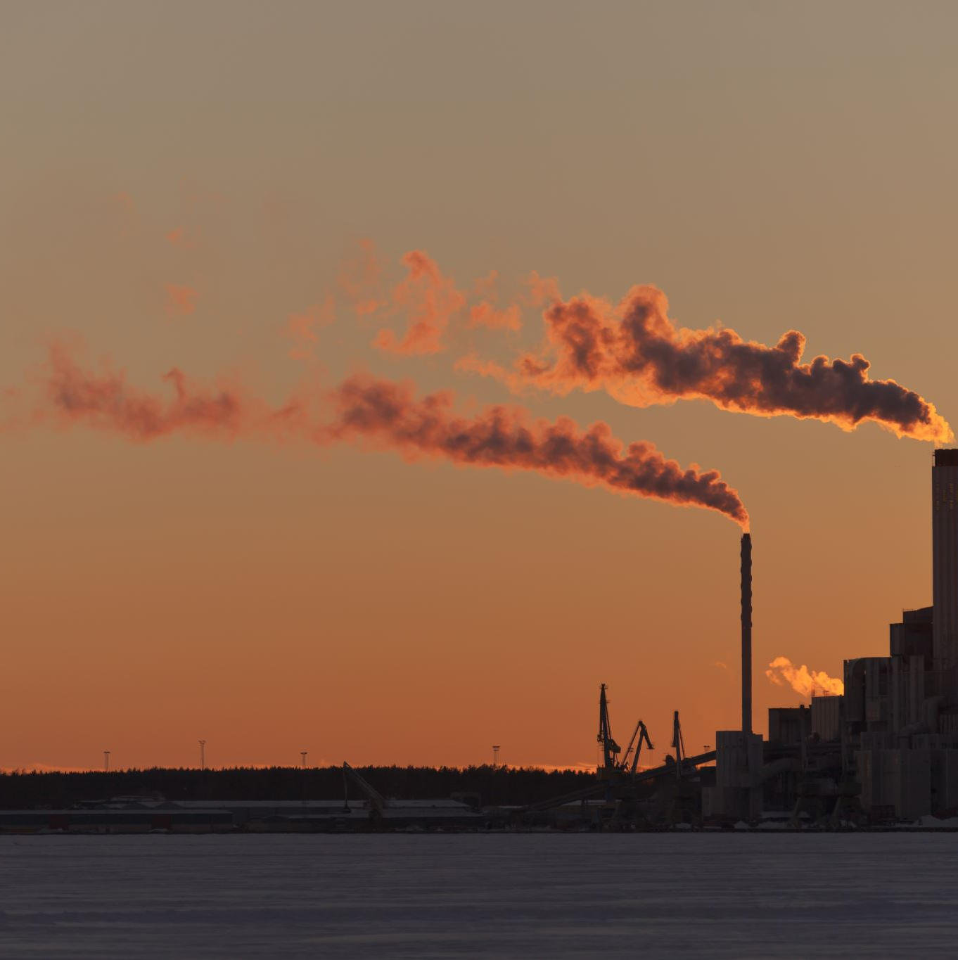
Reflection on Our Lifestyles
High energy consumption
Reliance on fossil fuels
Excessive vehicle emissions
Industrial pollution

Slide 10
Solutions to Prevent and Reduce Smog
Sustainable transportation options:
Use public transportation or carpool
Walking, cycling, or using electric vehicles
Cleaner energy sources and reduced energy consumption:
Transition to renewable energy (solar, wind, hydro)
Improve energy efficiency at home and work
Waste management and recycling
Support government policies and regulations for pollution control

Slide 11
Individual Actions for Clean Air
Reduce personal energy consumption
Plant trees and create green spaces
Minimize vehicle usage and adopt eco-friendly practices
Spread awareness and educate others about the issue

Slide 12
Collaborative Efforts
Community involvement in local environmental initiatives
Support for organizations working towards pollution control
Encouragement of sustainable practices in schools and workplaces

Slide 13
Conclusion
Take immediate action against smog and pollution!
Be proactive in reducing your own ecological footprint!

Slide 14
Questions and Answers

Slide 15
Geschwister-Scholl-Gymnasium Aachen, Germany

